Slide 1
Concurrent Force Systems
Dr. Jacob Moore
Associate Professor of Engineering
Penn State Mont Alto

Slide 2
Concurrent Forces
A set of forces are concurrent if the lines of action of all of the forces all come together at one point.
The line of action of a force is simply the line the force vector is acting along.

Slide 3
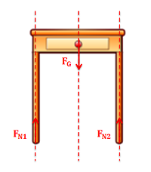
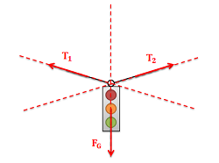
Concurrent Forces

Slide 4
Why Do We Care if the Forces Are Concurrent
If all the forces come together at a single location, then no force will exert a moment about that point.
If there are no moments to worry about, we can simplify the system analysis by treating the body as a particle at that point.
In particle analysis, we need to balance the forces, but we don’t need to worry about balancing the moments.

Slide 5
Thanks for Watching
See other engineering mechanics videos and access the full tool at…

